Slide 1
Indexes
Indexes are special data structures used to improve database performance.
SQL Server and MySQL Server automatically create an index on all primary and foreign keys.
Additional indexes may be assigned on other columns that are:
Frequently used in WHERE clauses.
Used for sorting data.

Slide 2
Indexes
Indexes are created to:
Enforce uniqueness on columns
Facilitate sorting
Enable fast retrieval by column values
Good candidates for indexes are columns that are frequently used with equal conditions in WHERE clause or in a join.
Examples:
CREATE INDEX CustNameIdx ON CUSTOMER(Name);
CREATE UNIQUE INDEX WorkUniqueIndex ON WORK(Title, Copy, ArtistID);

Slide 3
Indexes
SQL Server supports two kinds of indexes:
Clustered index: the data are stored in the bottom level of the index and in the same order as that index
Nonclustered index: the bottom level of an index contains pointers to the data
Clustered indexes are faster than nonclustered indexes for updating and retrieval.
MySQL Server supports three kinds of indexes:
B-Tree / Hash / R-Tree

Slide 4
SQL Server - Populating the Tables: The IDENTITY Keyword
The IDENTITY keyword implements a new constraint for surrogate keys.
IDENTITY (m, n) creates a surrogate key with an Identity Seed (StartValue) of m and an Identity Increment of n:
CREATE TABLE CUSTOMER(
CustomerID int NOT NULL IDENTITY (1000,1),
Name char(25) NOT NULL,
CONSTRAINT CustomerPK PRIMARY KEY (CustomerID),
CONSTRAINT CustomerAK1 UNIQUE (Name)
);

Slide 5
MySQL - Populating the Tables: The AUTO_INCREMENT Keyword
The AUTO_INCREMENT keyword implements a new constraint for surrogate keys.
The increment value is always one.
The starting value is initially one, but can be modified using an ALTER TABLE statement:
ALTER TABLE TRANS AUTO_INCREMENT = 100;

Slide 6
Oracle - Creating Views I
The CREATE VIEW statement can be used to create views in Oracle.
Unlike SQL-92, Oracle allows the ORDER BY clause in view definitions.
Oracle supports the JOIN…ON syntax.
Example:
CREATE VIEW CustomerInterests AS
SELECT C.LastName AS CustomerLastName,
C.FirstName AS CustomerFirstName,
A.LastName AS ArtistName
FROM CUSTOMER C JOIN CUSTOMER_ARTIST_INT CAI
ON C.CustomerID = CAI.CustomerID JOIN ARTIST A
ON CAI.ArtistID = A.ArtistID;

Slide 7
SQL/Persistent Stored Modules (SSL/PSM)
SQL/Persistent Stored Modules (SQL/PSM) is an ANSI/ISO standard for embedding procedural programming functionality into SQL.
Each DBMS product implements SQL/PSM in a different way, with some closer to the standard than others.
Microsoft SQL Server 2012 calls its version Transact-SQL (T-SQL).
Oracle Database 11g Release 2 calls its variant Procedural Language/SQL (PL/SQL).
MySQL 5.6 implements SQL/PSM, but has no special name for its variant of SQL.

Slide 8
SQL Server - Application Logic
SQL Server database applications can be processed using:
A programming language, e.g., C# .NET, C++. NET, Visual Basic.NET, to invoke SQL Server DBMS commands
PowerShell and the sqlps utility to invoke database commands stored in .sql files
The Microsoft SQL Server Management Studio to invoke database commands stored in .sql files
Stored procedures
Triggers

Slide 9
SQL Server - Application Logic
SQL Server implements a version of the standard SQL/Persistent Stored Modules (SQL/PSM)
SQL Server’s variant is called Transact-SQL (T-SQL)

Slide 10
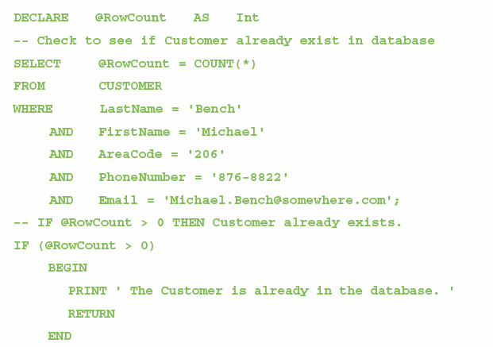
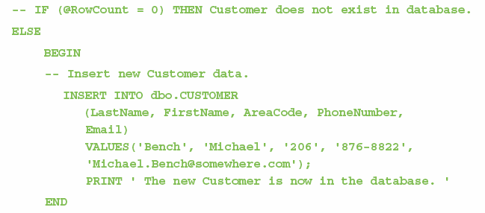
SQL Server - Application Logic: T-SQL Control of Flow Statements
IF…ELSE
BEGIN…END
WHILE
RETURN

Slide 11
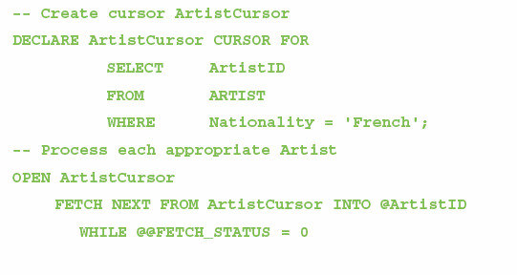
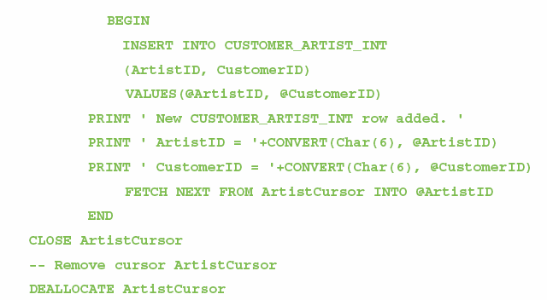
SQL Server - Application Logic: T-SQL Cursor Statements
DECLARE CURSOR
OPEN
FETCH
CLOSE
DEALLOCATE

Slide 12
Oracle - Application Logic
Oracle Database implements the SQL/Persistent Stored Modules (SQL/PSM) standard in the Oracle Database Procedural Language/SQL (PL/SQL).
Oracle Database also supports the use of the Java programming language for writing Oracle Database functions, stored procedures and triggers.

Slide 13
Oracle - Application Logic II
Oracle database applications can be processed using:
Programming languages to invoke DBMS commands
The SQL*Plus Command Line utility to invoke database commands stored in .sql files
The SQL Developer to invoke database commands stored in .sql files
Stored procedures
Triggers

Slide 14
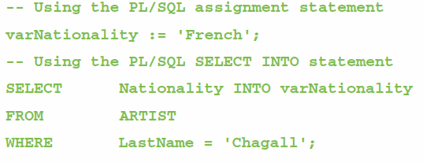
Oracle - Application Logic: Parameters and Variables
A parameter is a value passed to a stored procedure.
A variable is a value used within the stored procedure.

Slide 15
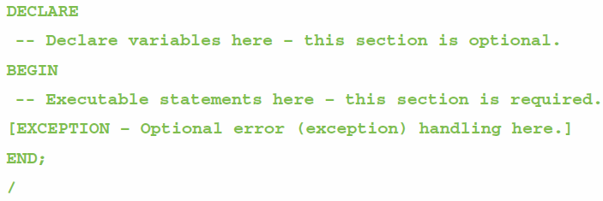
Oracle - Application Logic: Oracle Block Structure
Oracle blocks must end with a single slash (/) as a signal to compile and execute the code to create the procedure or trigger:
This is a slash (/)

Slide 16
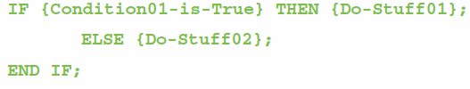
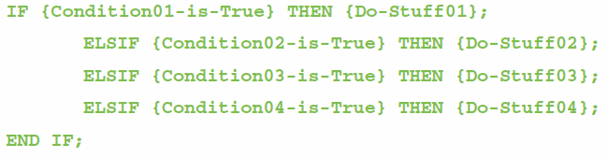
Oracle - Application Logic: Oracle Control of Flow Statements I
IF…THEN…ELSE…END IF
IF…ELSIF…END IF

Slide 17
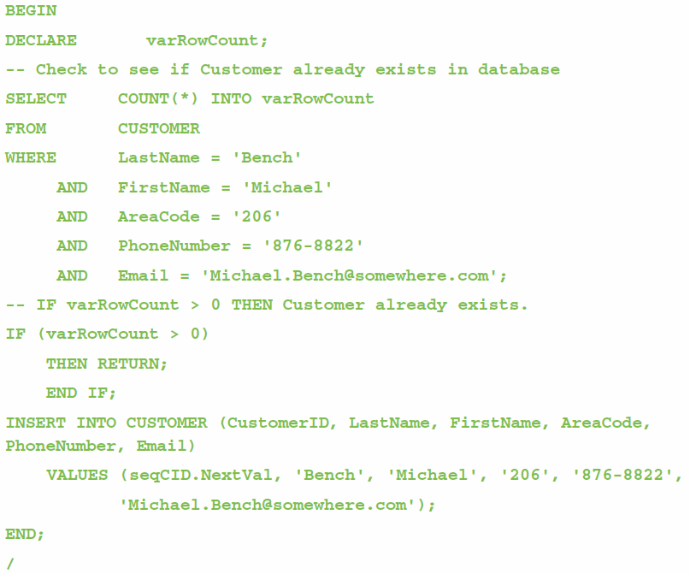
Oracle - Application Logic: Oracle Control of Flow Statements II
BEGIN…END
RETURN

Slide 18
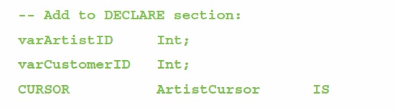
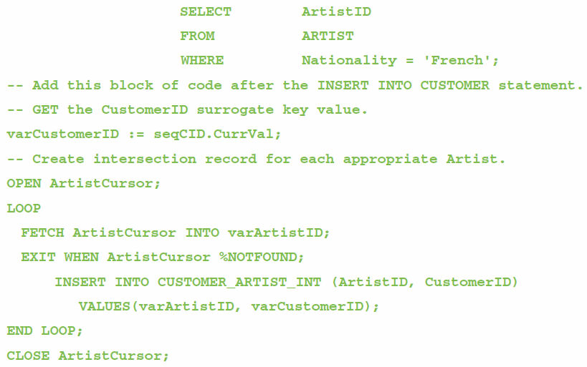
Oracle - Application Logic: Oracle Cursor Statements
DECLARE
OPEN
FETCH
LOOP
FOR
WHILE
EXIT WHEN
CLOSE

Slide 19
MySQL - Application Logic
MySQL Server implements the SQL/Persistent Stored Modules (SQL/PSM) standard, but does have a special name for the MySQL variant of SQL—it is just called SQL!

Slide 20
MySQL - Application Logic
MySQL Server implements the SQL/Persistent Stored Modules (SQL/PSM) and is simply called SQL!
MySQL Server database application can be processed using:
Programming languages to invoke SQL Server DBMS commands
The MySQL Command Line utility to invoke database commands stored in .sql files
The MySQL Query Browser to invoke database commands stored in .sql files
Stored procedures
Triggers

Slide 21
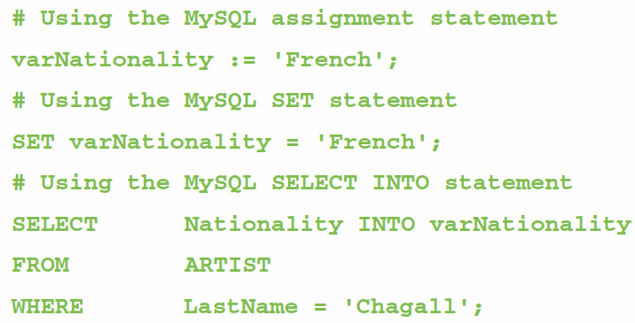
MySQL - Application Logic: Parameters and Variables
A parameter is a value passed to a stored procedure.
A variable is a value used within the stored procedure.

Slide 22
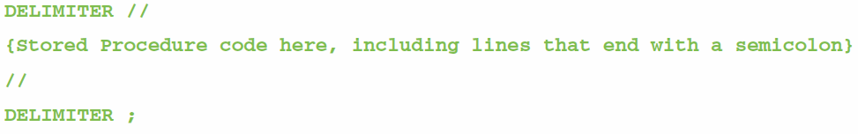
MySQL - Application Logic: MySQL Statement Delimiters
MySQL must use a delimiter other than the SQL semicolon(;) when creating stored procedures and triggers:
This is a semicolon (;)

Slide 23
MySQL - Application Logic: MySQL Block Structure
MySQL blocks must begin with BEGIN and end with END without semicolons.
BEGIN
DECLARE {optional}
{Executable statements {required}
END

Slide 24
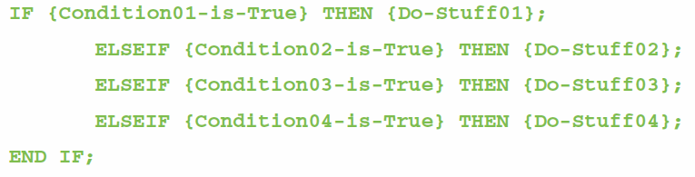
MySQL - Application Logic: MySQL Control of Flow Statements
IF…THEN…ELSE…END IF
IF…ELSEIF…END IF

Slide 25
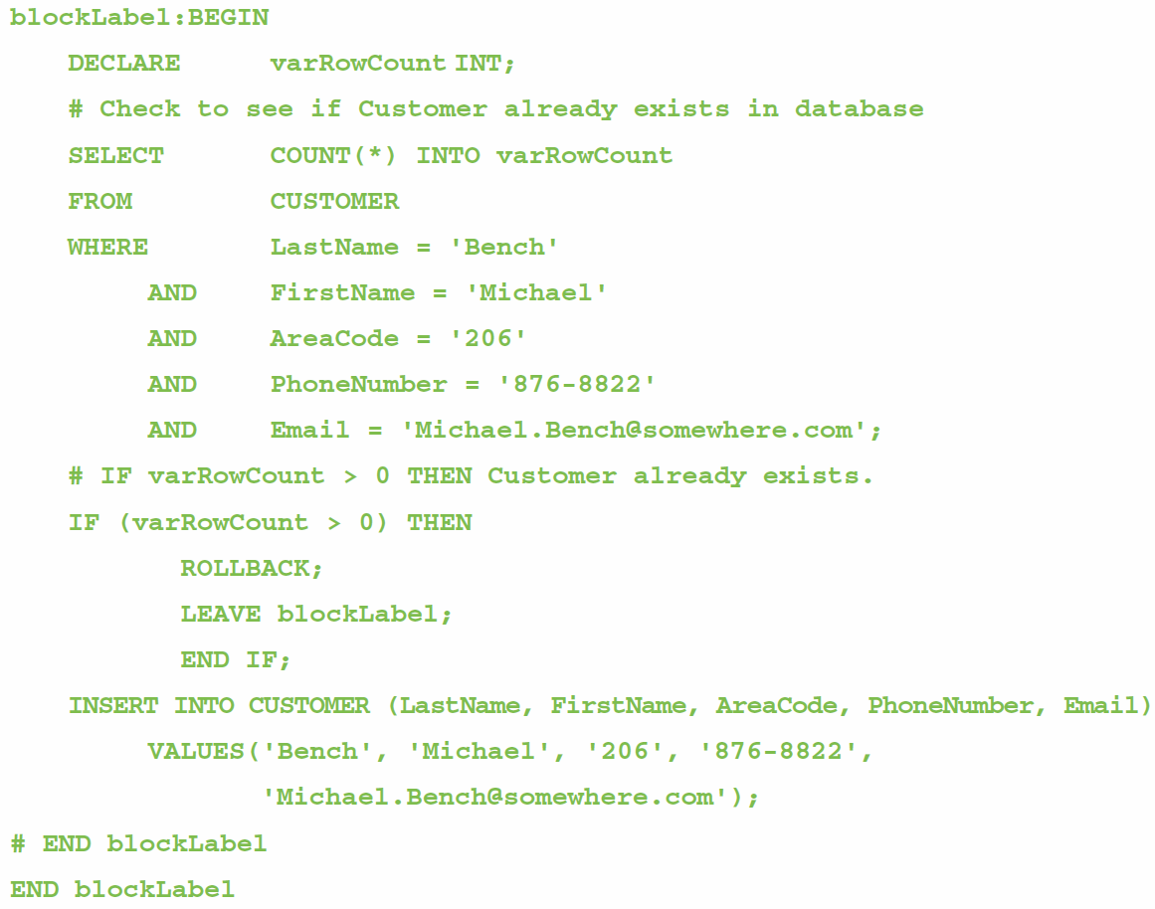
MySQL - Application Logic: MySQL Control of Flow Statements
BEGIN…END
Block Labels
ROLLBACK
LEAVE

Slide 26
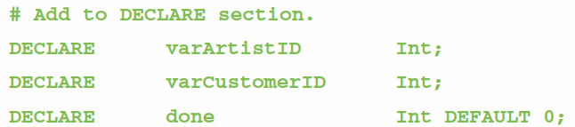
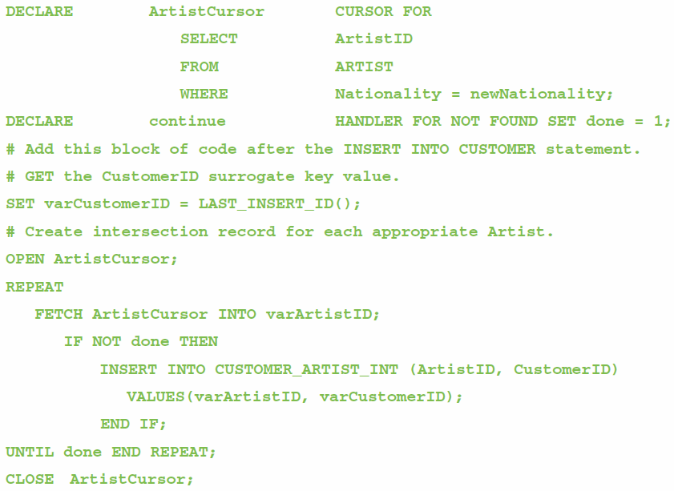
MySQL - Application Logic: MySQL Cursor Statements
DECLARE
OPEN
FETCH
CLOSE

Slide 27

User-Defined Functions
A user-defined function (stored function) is a stored set of SQL statements that:
is called by name from another SQL statement
may have input parameters passed to it by the calling SQL statement, and
returns an output value to the SQL statement that called the function.

Slide 28
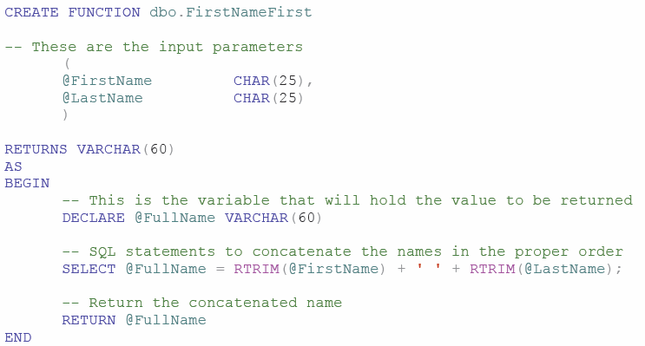
SQL Server - User-Defined Functions The FirstNameFirst Function

Slide 29
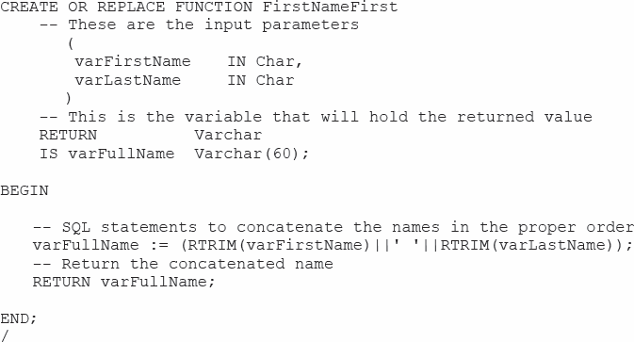
Oracle - User-Defined Functions The FirstNameFirst Function

Slide 30
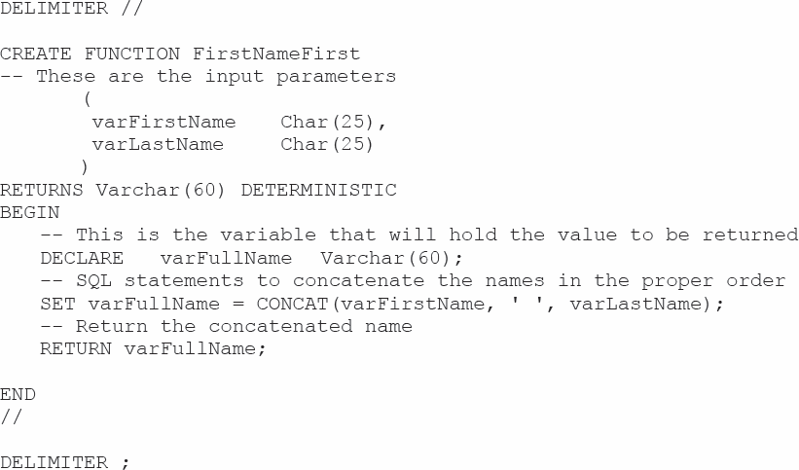
MySQL - User-Defined Functions The FirstNameFirst Function

Slide 31
User-Defined Functions The FirstNameFirst Function
Using the FirstNameFirst function:
SELECT dbo.FristNameFirst(FirstName, LastName) AS CustomerName,
Sreet, City, State, ZipPostalCode
FROM CUSTOMER
ORDER BY CustomerName;

Slide 32
SQL Server - Stored Procedures
A stored procedure is a compiled program stored within the database.
Transact-SQL surrounds basic SQL statements with programming constructs such as parameters, variables, and logic structures such as IF and WHILE.
Stored procedures are programs that can:
Have parameters.
Invoke other procedures and functions.
Return values.
Raise exceptions.
Creating stored procedures:
Write a stored procedure in a text file and process the commands using the Microsoft SQL Server Management Studio.

Slide 33
Oracle - Stored Procedures
A stored procedure is a PL/SQL or Java program stored within the database.
Stored procedures are programs that can:
Have parameters.
Invoke other procedures and functions.
Return values.
Raise exceptions.
A stored procedure must be compiled and stored in the database.

Slide 34
My SQL - Stored Procedures
A stored procedure is a compiled program stored within the database.
Stored procedures are programs that can:
Have parameters.
Invoke other procedures and functions.
Return values.
Raise exceptions.
Creating stored procedures:
Write a stored procedure in a text file and process the commands using the MySQL Query Browser

Slide 35
SQL Server - Triggers
An SQL Server trigger is a procedure that is invoked when a specified database activity occurs.
Triggers can be used to:
Enforce business rules.
Set complex default values.
Update views.
Implement referential integrity actions.
SQL Server only supports INSTEAD OF and AFTER triggers.
A table may have one or more AFTER triggers.
AFTER triggers may not be assigned to views.
A view or table may have only one INSTEAD OF trigger for each triggering action.
Triggers can roll back the transactions that caused them to be fired.

Slide 36
Oracle - Triggers
An Oracle trigger is a PL/SQL or Java procedure that is invoked when a specified database activity occurs.
Triggers can be used to:
Set default values.
Enforce a Data Constraint.
Update a view.
Enforce referential integrity action.
Handle exceptions.

Slide 37
Oracle - Triggers
Trigger types:
A command trigger will be fired once per SQL command.
A row trigger will be fired once for every row involved in the processing of an SQL command.
There are three types of row triggers: BEFORE, AFTER, and INSTEAD OF.
BEFORE and AFTER triggers are placed on tables while INSTEAD OF triggers are placed on views.
Each trigger can be fired on INSERT, UPDATE, or DELETE commands.

Slide 38
MySQL - Triggers
MySQL Server only supports BEFORE and AFTER triggers.
Without the INSTEAD OF trigger, triggers on SQL views are not supported.
MySQL trigger support is very limited, and triggers may not be used to:
Make a change in the table that fired the trigger.
Return an output value—triggers can use the LEAVE keyword to exit without returning a value.
Make implicit or explicit ROLLBACKs of COMMITs.

Slide 39
SQL Server - Concurrency Control
Three factors determine the concurrency control behavior of SQL Server.
Transaction isolation level
Cursor concurrency setting
Locking hints provided in the SELECT clause
Locking behavior also changes, depending on whether actions occur in the context of transactions or cursors independently.
Therefore, SQL Server places locks on behalf of the developer.
Locks may be placed at many levels of granularity and may be promoted or demoted as work progresses.

Slide 40
Oracle - Concurrency Control
Oracle processes database changes by maintaining a System Change Number (SCN).
SCN is a database-wide value that is incremented by Oracle when database changes are made.
With SCN, SQL statements always read a consistent set of values; those that were committed at or before the time the statement was started.
Oracle only reads committed changes; it will never read dirty data.

Slide 41
MySQL - Concurrency Control
One factor determines the concurrency control behavior of MySQL:
Transaction isolation level
Lock types include:
Record locks—a lock on the index record
Gap locks—generally, a lock on the unused index numbers between index records (see the MySQL documentation)
Next-Key locks—a combined record lock on the index record together with a gap lock on the unused index numbers before the index record itself

Slide 42
Oracle Sequences
A sequence is an object that generates a sequential series of unique numbers.
Create Sequence CustID Increment by 1 start with 1000;
It is the best way to work with surrogate keys in Oracle.
Two sequence methods:
NextVal provides the next value in a sequence.
CurrVal provides the current value in a sequence.
Using sequences does not guarantee valid surrogate key values because it is possible to have missing, duplicate, or wrong sequence values in the table.

Slide 43
Oracle - Using Sequences
Creating a sequence:
CREATE SEQUENCE seqCID INCREMENT BY 1 START WITH 1000;
Entering data using a sequence:
INSERT INTO CUSTOMER
(CustomerID, Name, AreaCode, PhoneNumber)
VALUES(
seqCID.NextVal, 'Mary Jones', '350', '555–1234');
Retrieving the row just created:
SELECT *
FROM CUSTOMER
WHERE CustomerID = seqCID.CurrVal;

Slide 44
Oracle - The TO_DATE Function
Oracle requires dates in a particular format.
TO_DATE function may be used to identify the format:
TO_DATE('11/12/2013', 'MM/DD/YYYY')
11/12/2011 is the date value.
MM/DD/YYYY is the pattern to be used when interpreting the date.
The TO_DATE function can be used with the INSERT and UPDATE statements to enter data:
INSERT INTO T1 VALUES(
100, TO_DATE ('01/05/2013', 'DD/MM/YYYY'));

